Slide 1
Contact: Carrie Chen
Email: carrie@dgqinxin.com
Phone/wechat: + 13544688138

Slide 2
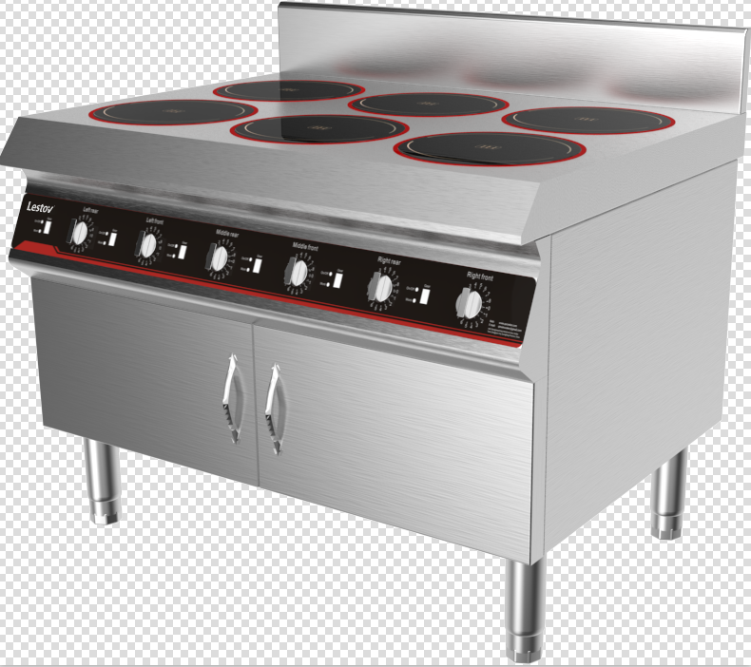
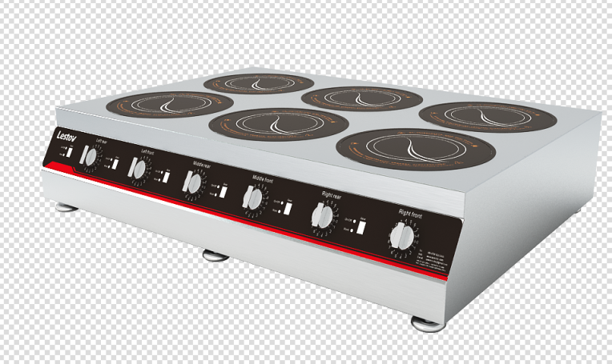
Commercial Induction 6 Burners
Model No. | Power Voltage | Product Size | Material
LT-TBZ300Ⅵ-B13 | 3 KW*6 /230V/50HZ | Glass￠300·Heat￠210 L1050*W800*H330 | SUS 304
LT-B300Ⅵ-B135 | 3.5KW*6 / 50Hz 400V | Glass￠300·Heat￠210mm L1050*W800*H800+150mm | SUS 304
Power/Frequency: 3 kw*6 & 3.5KW*6 /50-60Hz
Voltage: 230V 1 phase or 400 V 3 phase
Flexible wiring method : 230V or 400 V
Glass thickness: 6mm
Maximum glass load： ≦ 100KG
Heating area:￠210mm
pan suitable material: Cast Iron
Working environment: Humidity 30%-90% ; Temperature -5℃-40℃
Application : cafes bar, bakery, food truck, traveling food stalls and fast food restaurant.
💥 Induction heating technology 1)Up to 92% thermal efficiency 2)40% energy saving than gas operated 3)High frequency coil ,no blind heating area 💥 Easy operation 1)6 burners working independently 2) 360˚ Knob switch & 8 power rating 3) Built-in safety protection and error code display system 4) Fully mould 304 SUS ,easy clearing 💥 Safety & ECO –friendly 1) no open fire & no fire hazard & no smoke & no Grease & Odor free 2) Reduce temperature & noise & Enhance working environment

Slide 3
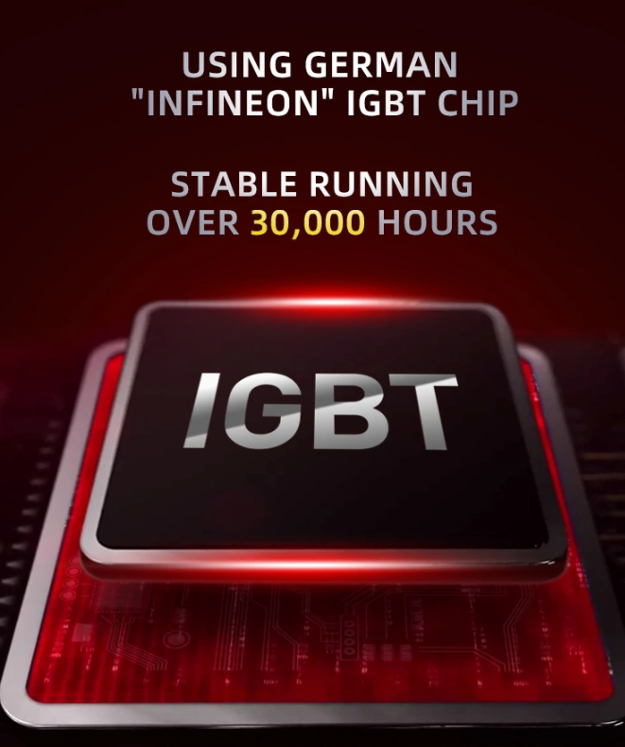
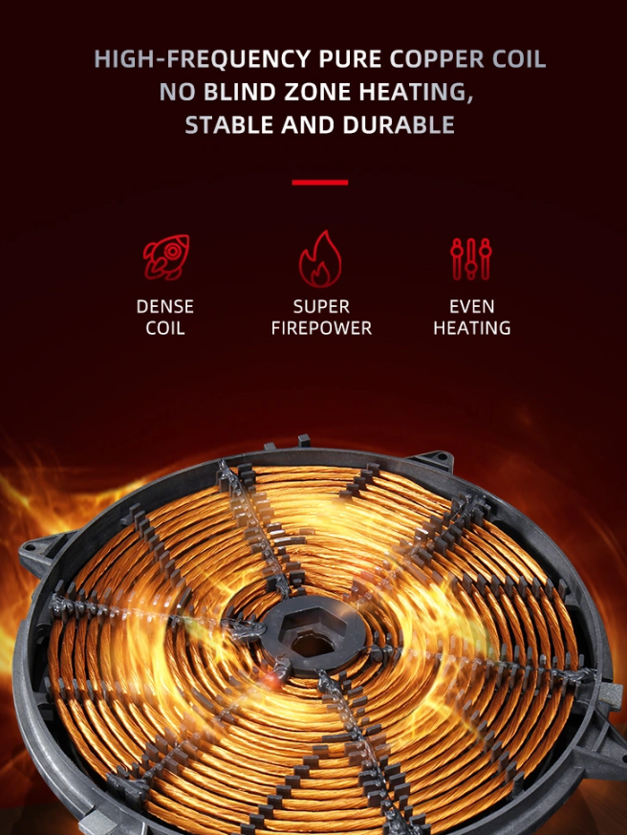
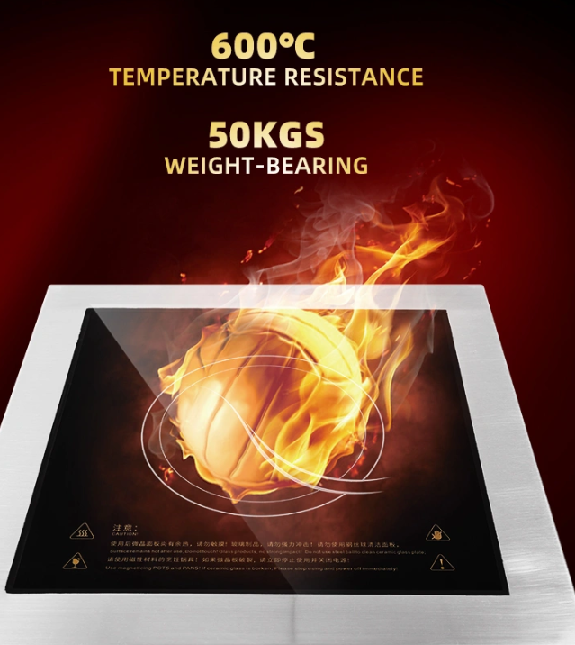
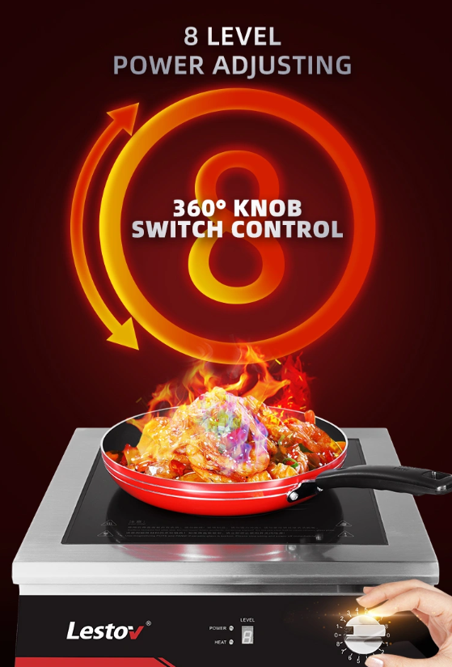
Component of Commercial Induction 6 Burners

Slide 4
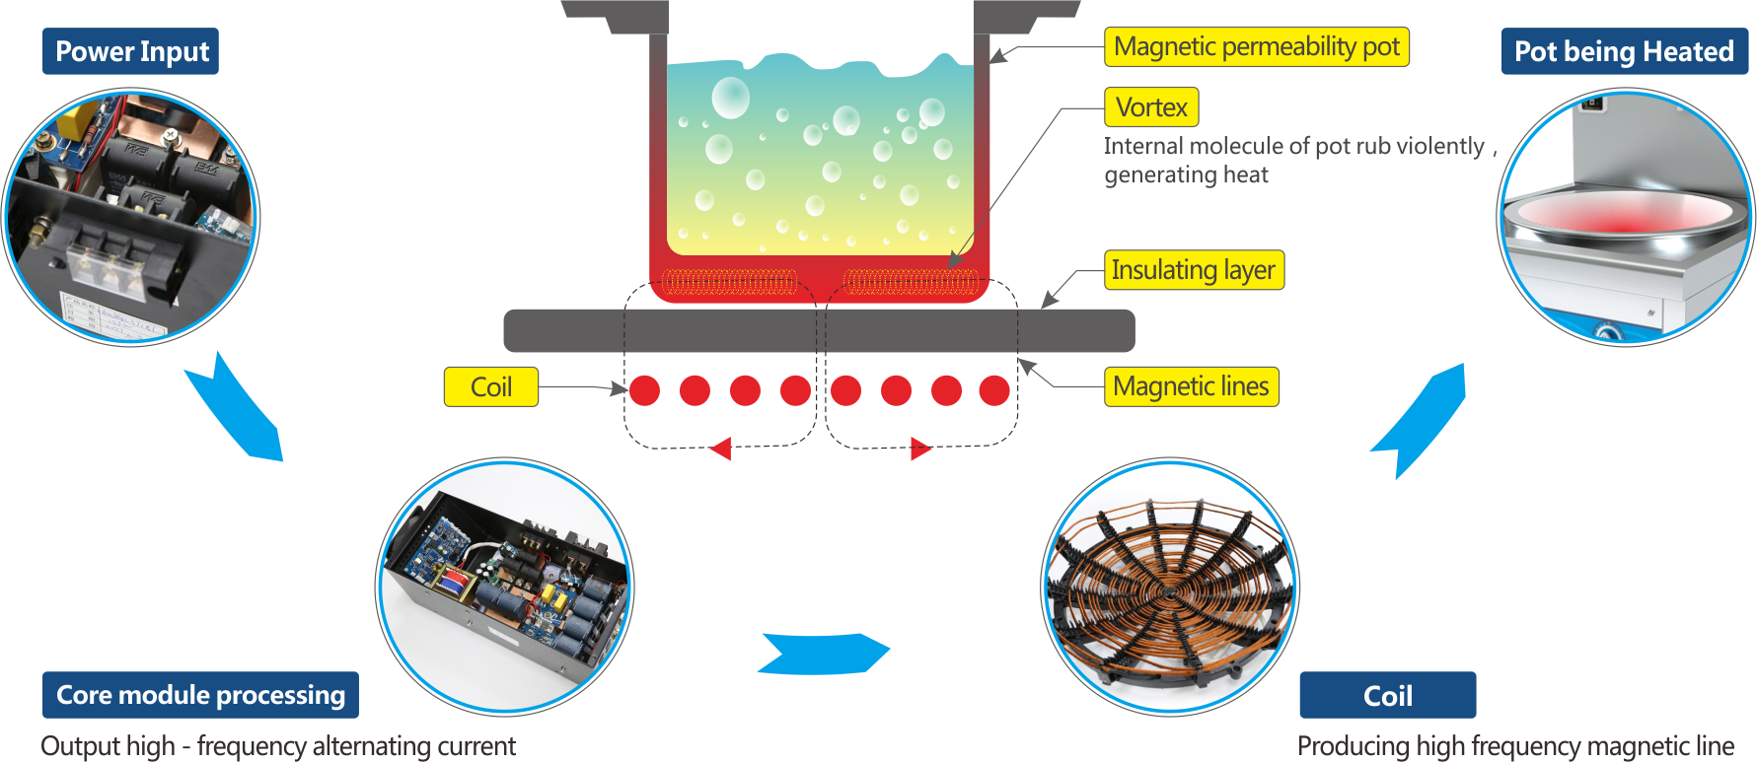

Slide 5
