Slide 1
Contact: Carrie Chen
Email: carrie@dgqinxin.com
Phone/wechat: + 13544688138

Slide 2
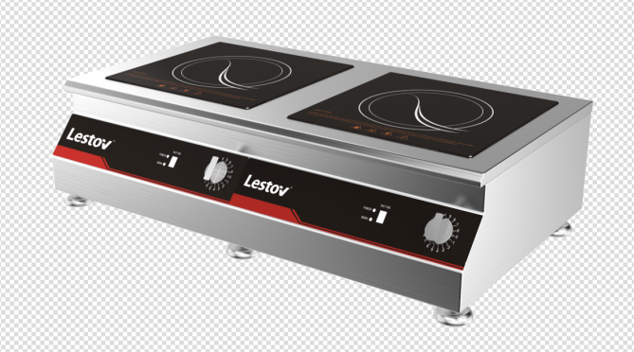
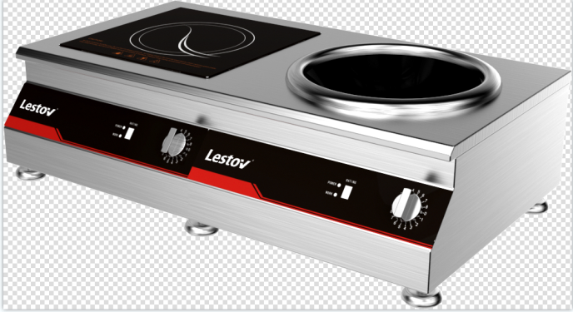
Commercial double induction cooker
Model No. | Power Voltage | Product Size | Material
GXIH2-3 | 3KW*2 /230V/50Hz | Glass:330*330mm L800*W470+50*H180mm | SS304
GXIH-1+W | 3KW*2 /230V/50Hz | Glass:330*330mm Pot￠400 L800*W470+50*H240mm | SS304
Power/Frequency: 2 *3 KW /50-60Hz
Voltage: 230V,single phase
Range of voltage fluctuation: 220v +/- 40%
Glass thickness:4mm
Maximum glass load： ≦ 50KG
pan suitable material: Cast Iron
Working environment: Humidity 30%-90% ; Temperature -5℃-40℃
Application : cafes bar, bakery, food truck, traveling food stalls and fast food restaurant.
💥 Induction heating technology 1)Up to 92% thermal efficiency 2)40% energy saving than gas operated 3)High frequency coil ,no blind heating area 💥 Easy operation 1) Compact & portable 2) 360˚ Knob switch & 8 power rating 3) Built-in safety protection and error code display system 4) Fully mould 304 SUS ,easy clearing 💥 Safety & ECO –friendly 1) no open fire & no fire hazard & no smoke & no Grease & Odor free 2) Reduce temperature & noise & Enhance working environment

Slide 3
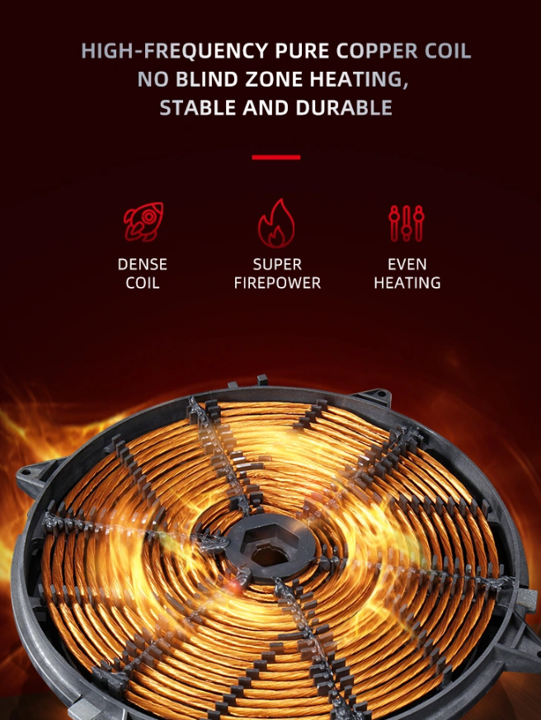
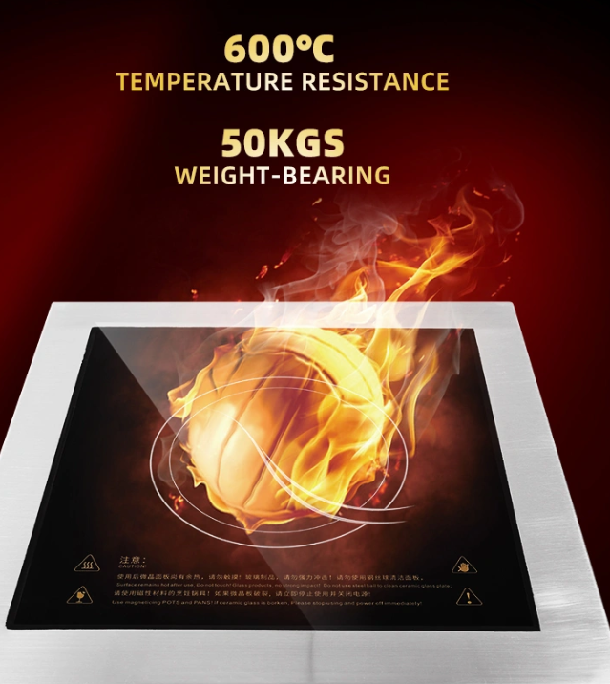
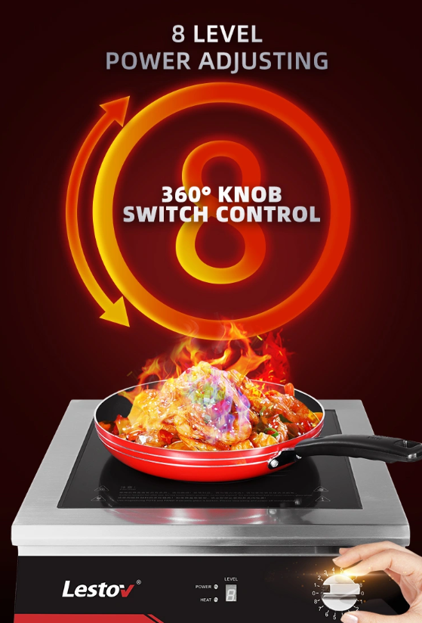
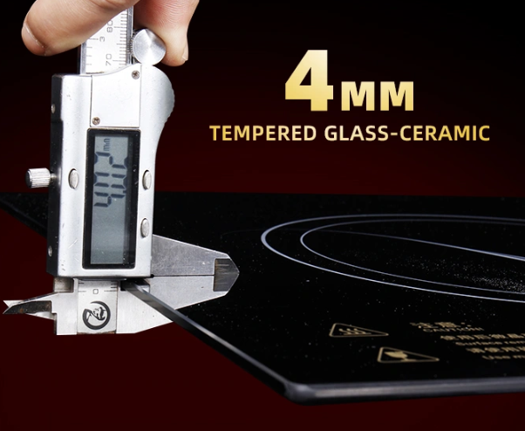
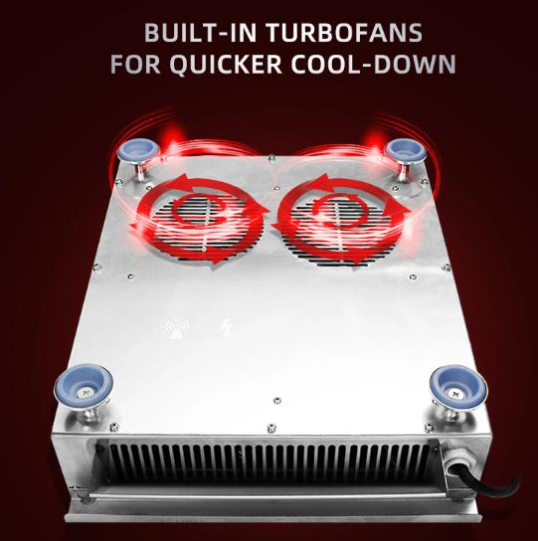
Component of double induction cooker
Anti-Slip foot design

Slide 4
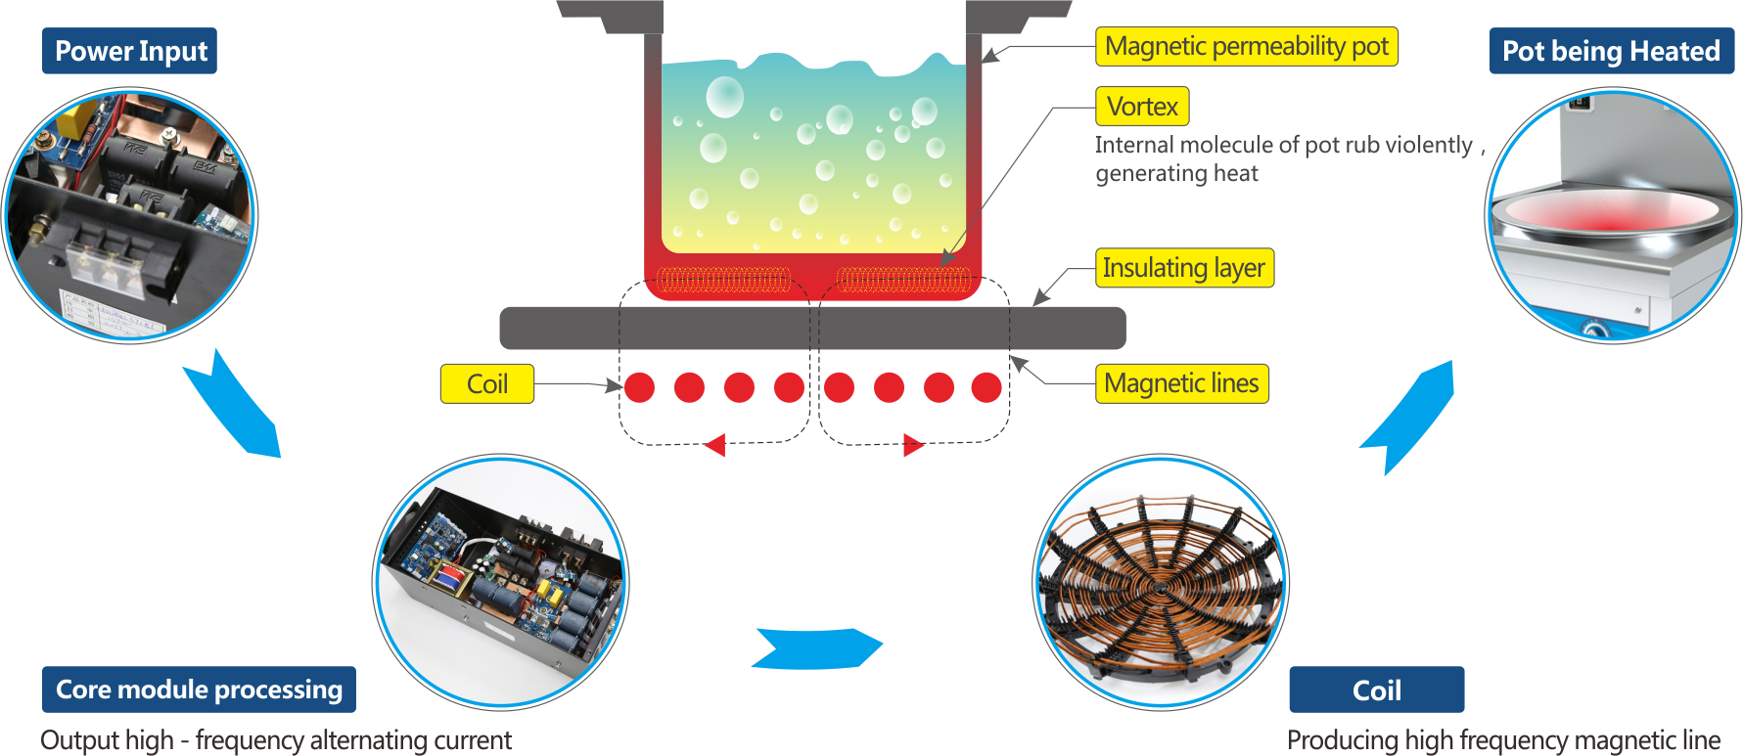

Slide 5
